Slide 1
Digital Photography B Unit 6 Portfolio
By Aiden Krieger
Camera Used: Canon PowerShot SX530 HS

Slide 2
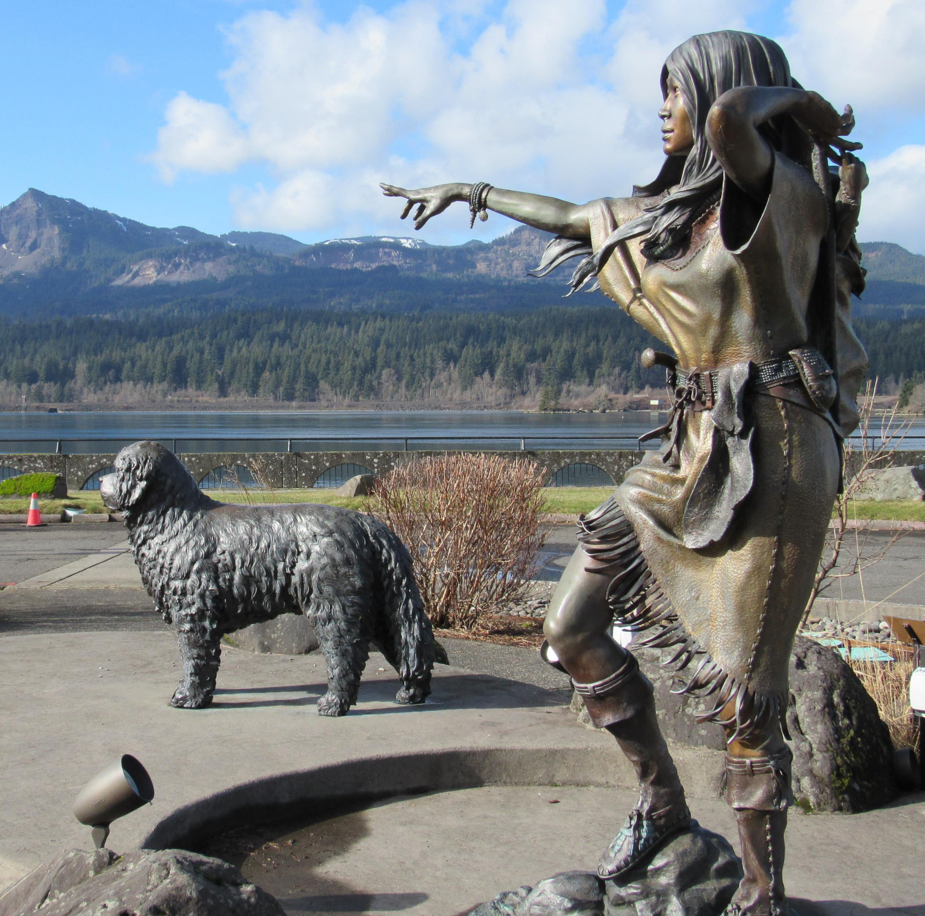
One day, Sacagawea, along with her loyal companion, were looking for a fishing platform to use so they could get some fish from the Columbia River. They were both very hungry and running out of food supplies. They looked all day but could not find a fishing platform that was open.

Slide 3
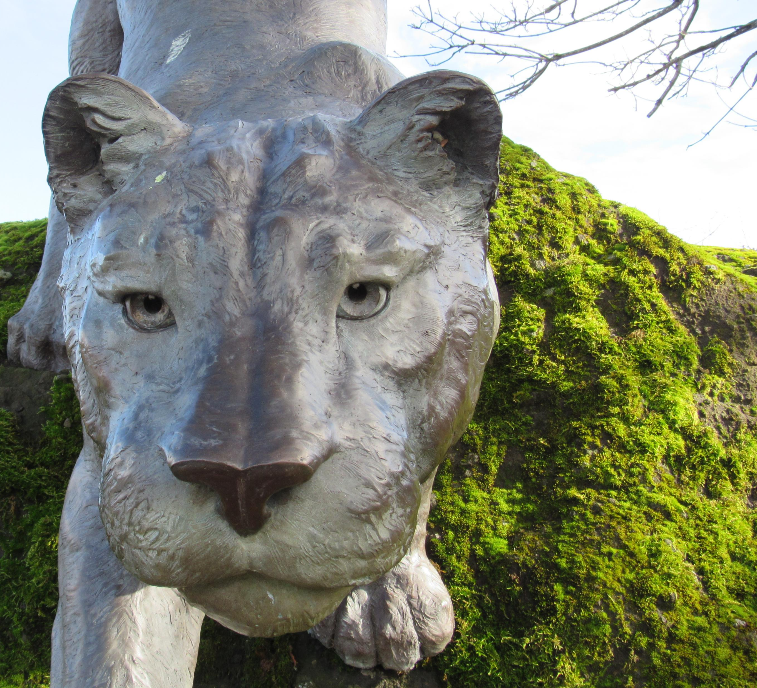
So, Sacagawea decided to look for a fishing platform during night. Eventually, she found one. It looked like a great place that you could easily find some fish. She decided to get her fishing supplies (Her reel, hook, some bait, and a couple fish nets just in case) out and start fishing. Little did she know that she was being watched by a cougar who would try to take all her fish for itself.

Slide 4
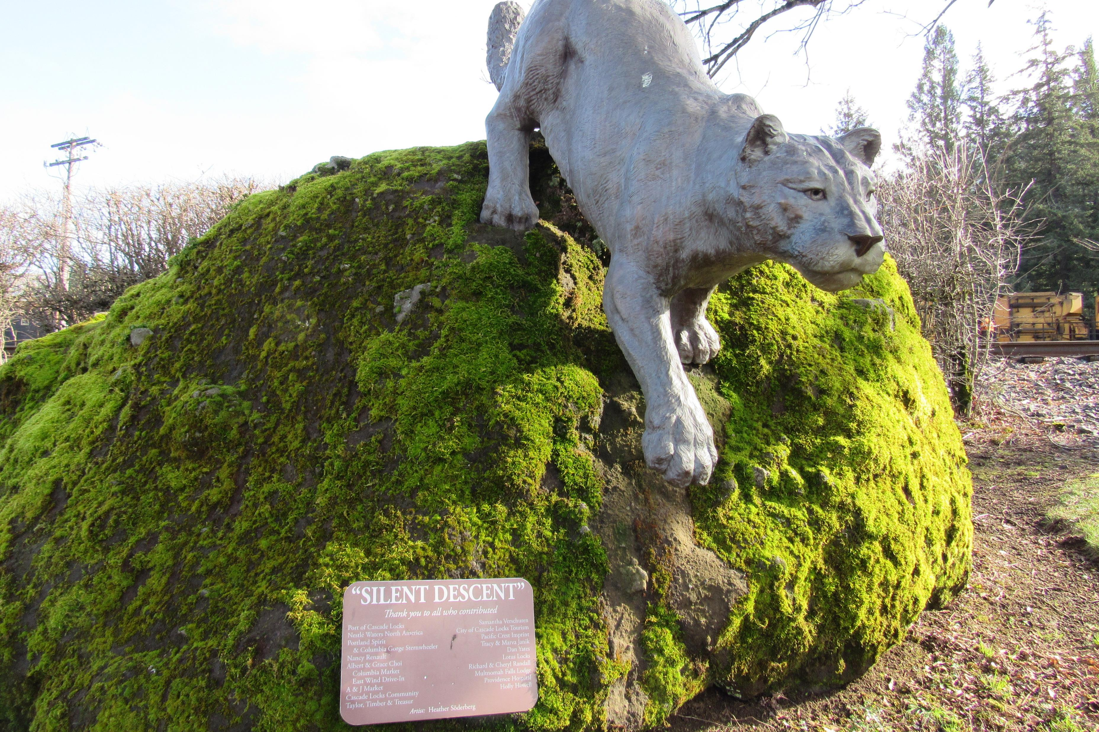
After Sacagawea got a total of 12 fish, she decided to pack it up for the night and get ready to head back to her tent. When she was getting ready to jump off the fishing platform and back onto land, she saw a seagull that was intensely staring at her fish. Sacagawea then remembered what her mother said, “If you see a seagull looking directly at your fish, then it means something is behind you.” Surely enough, Sacagawea looked behind her and saw the cougar, who was getting ready to steal the fish.

Slide 5
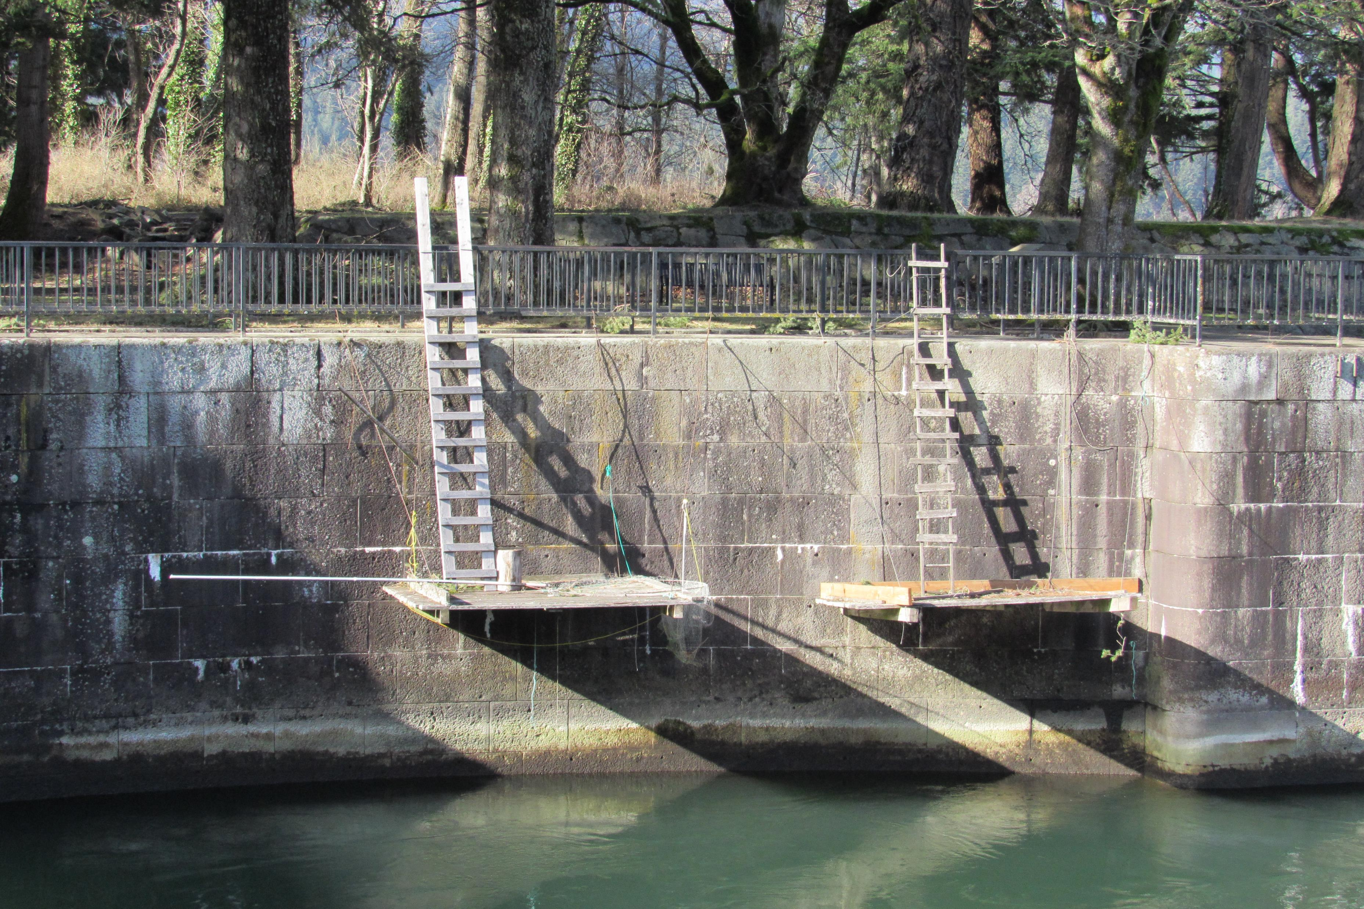
Sacagawea, knowing what the cougar was wanting, decided to give it the fish, then quickly jumped into the ocean so that the cougar would not eat her. Across the river, she saw another fishing platform, and swam to it as fast as possible. She then got her fishing supplies and decided to get more fish since she lost all of them to the cougar. Surprisingly, she got 16 fish, which is 4 more than what she had originally. By the time this happened, the sun started to rise.
The Cougar saw that Sacagawea got even more fish but could not get to her to try to steal the fish because he was afraid of going into the river and getting wet. He decided to take his 12 fish he got and left without a trace.
For now, Sacagawea was safe and still got the food supplies she was needing.

Slide 6
Reflection:
What did I like about each of my photographs: I liked how I was easily able to create a story using them.
What could I improve?
Answer: On several of these photos, I could have probably improved the angle that I took the photo at. Besides that, it looks like the photos were perfect to make this story.

