Slide 1
Photo Critique Artist: Gregory Crewdson
Aeris Reeves
Digital Photography 1B U8 Activity
3/19/23

Slide 2
The following images were taken by Gregory Crewdson.

Slide 3
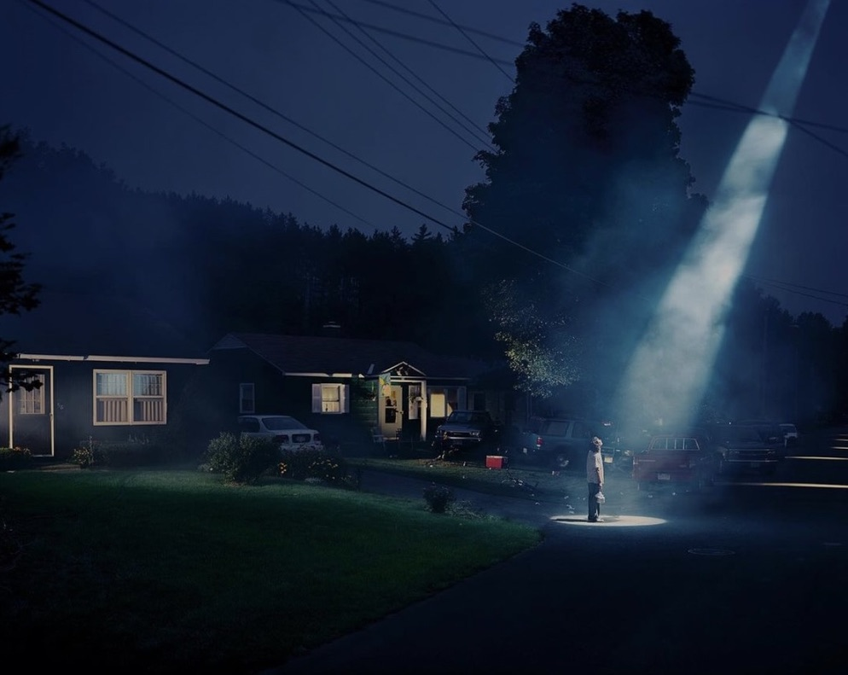
The subject of this photo appears to be a person standing at the end of a driveway. Your eye is lead to the subject by a beam of light coming from the sky. The photo also uses the rule of thirds. This photo has an eeriness that is almost serene and most definitely mysterious. To make the photo feel more dramatic, you could decrease the brightness and highlights in the image while increasing the brilliance.

Slide 4
This photo is centered around the subject, which stands out against the bright background of the snowy scenery. It feels fun and adventurous, but also peaceful. To improve the photo, you could decrease the shadows and increase the saturation of blue and yellow, as well as the overall saturation and color cast of the image.

Slide 5
This photo is also centered on the subject, which appears to be a man repairing/building something. There is much backlighting surrounding the subject, making it stand out. There are also many hard lines in the image which lead your eyes to the subject. This image feels very realistic and down to earth. To improve the photo, you could crop it to bring more focus onto the subject. You could also decrease the brightness and increase the color cast.

Slide 6
The subject of this photo is a woman leaning against the back of a car. The brightly colored woman and the car stand out against the dull building in the background, and there are many lines leading your eyes towards the woman. This photo feels very calm and casual. I think that this photo could be improved by decreasing the shadows and increasing the highlights and saturation.

Slide 7
This photo appears to follow the rule of thirds. The lines of the building lead your eyes to a shoeless man sitting on the building’s step, who seems to be the subject of the photo. The image has a very serious tone and heavy atmosphere. It feels mysterious and concerning. I think that this photo could be improved by decreasing the brightness and highlights and increasing the brilliance and black point.

